Slide 1

Google Meet Planner
Nipun Verma
Email: nipunverma2k17@gmail.com
Contact: 9958065802

Slide 2
Disclaimer
The design template used here is a modified version of an already existing video call app on FIGMA, it was a free resource available to use. I do not own this template.
The real creator is: https://www.figma.com/community/file/833454139625577548
This template is heavily modified to include new features, and all the modifications are original and are my own ideas.
Link to the design: you can find the file here.

Slide 3
Google Meet Planner
A little context of what this idea is about:
This app is an extension of the already existing Google Product called ‘Google Meet’ which is a video conference tool used by organisations as well as for personal purposes.
It helps people plan their trips with much more ease.

Slide 4
Why redesign Google Meet?
The main idea here is ‘Trip Planning’. Since the beginning of COVID, people have been staying at their homes all the time and we generally see that they tend to connect over video calls to talk about their life, office work and plan their meetups and trips, so why not integrate a trip planner for them within the app that will give them easier access to what they want?
Main focus: Since Google is already a huge company with well-defined revenue sources, I’d want to look at user engagement as the main purpose of this product redesign. Later, we can brainstorm over if this idea can be further extended to bring in more revenue or not.

Slide 5
Customer Segments?
Since Google is worldwide used product, it would be very hard to look at all the customer segments, as the number would be overwhelmingly large.
Let’s have a look at the customer base that we will be focussing on. Majorly the ‘new working people’ (who recently started working after their graduation) and ‘college folks’ are the ones who tend to plan trips very often, so I’d like to lay emphasis on these sections to narrow down the problem scope.
Other sections like, experienced professionals and elderly are not considered as from personal experience, I can be sure that these section of people tend to travel a lot less, and whenever they do, it is mainly with their families only, so using Google Meet there is somewhat redundant.

Slide 6
What do the Customers Want?
As a user myself, I’d want everything in a single place, I would like a feature that would reduce the number of times I have to switch between Google Meet and any other app while I am in a video call with some friends or family members, it gets annoying after a while.
I would like to go forward with this goal in mind.
Customers will be satisfied if their multiple needs are fulfilled in a single place. Who wouldn’t want that?

Slide 7
Possible Solutions?
Let’s focus mainly on the trip planning aspect of this scenario, forget about the video call. If I were to plan a trip, I’d like to have:
A list of places that I wish to visit
Best time to visit that place, what kind of clothes do I need to pack
The route I’ll have to take to get there
An itinerary basically.
A way the route issue can be solved is by integrating another one of Google’s products here, yes you guessed it right! Google Maps. Having Google Maps at our disposal within the video call will save a lot of time lost between switching, minimizing the meet, getting a perfect view between the 2 apps, etc.

Slide 8
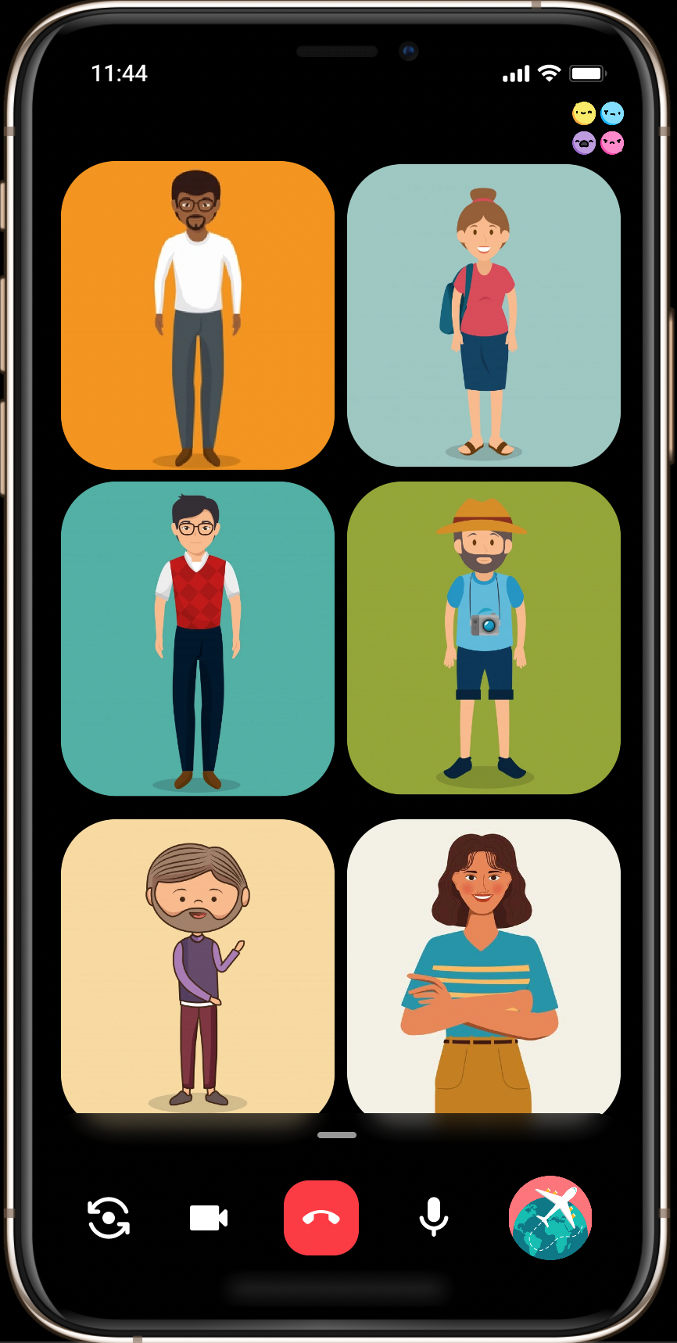
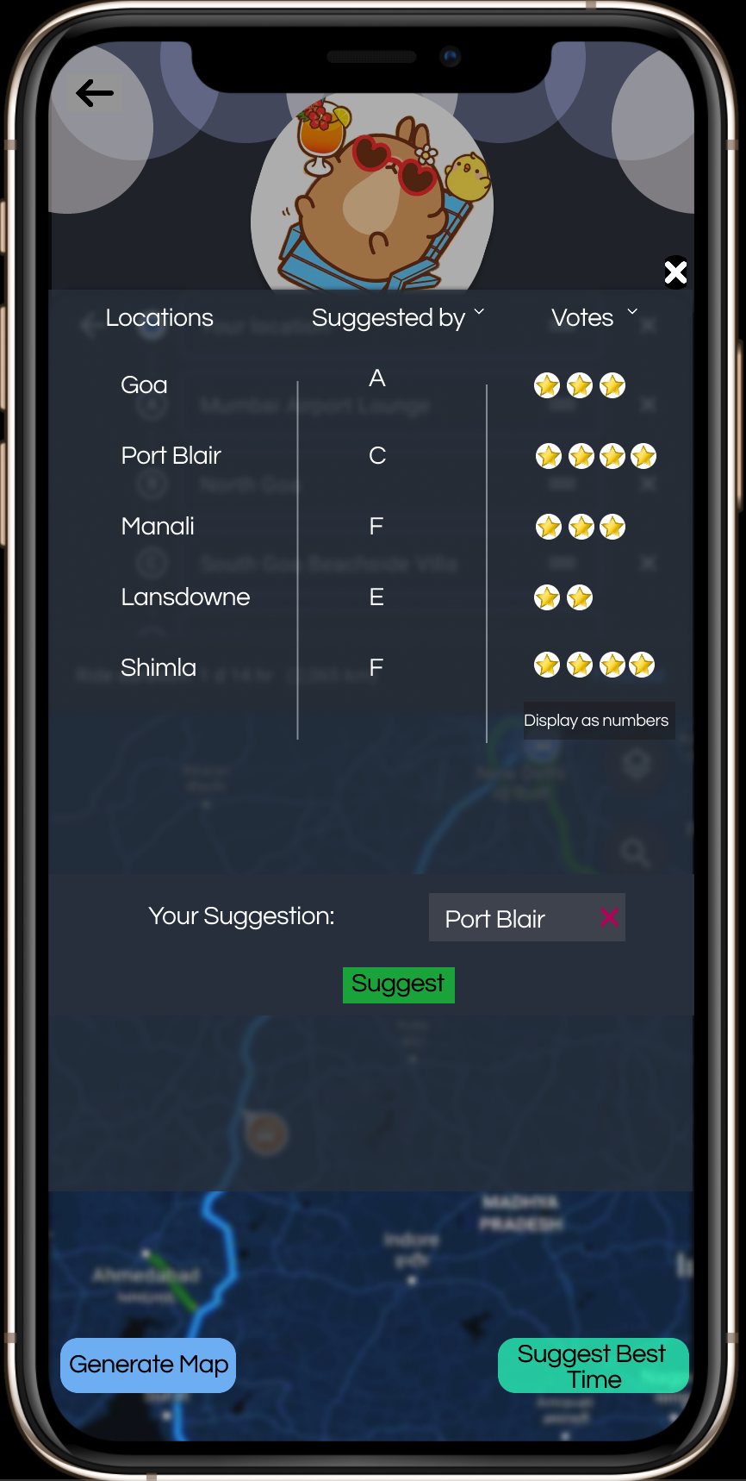
(This is discussed later)
Chat box and
Reactions
The reactions are modern floating emojis, making it look a bit more aesthetic
Our Feature

Slide 9
Okay, so now we have the map which can show us the distance, time and the route we should take to reach the destination. But where do we want to visit? This answer is consensual, everyone will suggest some location that they’d like to visit and there will be some disagreements too, but how to keep track of that?
Let’s add a small feature, this will let the users put in their suggestions for the places they should visit. But this doesn’t entirely solve the problem, so we need a system in which people vote out the least liked places. We give each person 1 vote for each suggested location, and they can either choose to vote it or not.
People are not allowed to vote multiple times on a single suggestion.
If a member suggests a location that has already been suggested by someone else, then their suggestion is rejected with a prompt ‘this location already exists’.

Slide 10
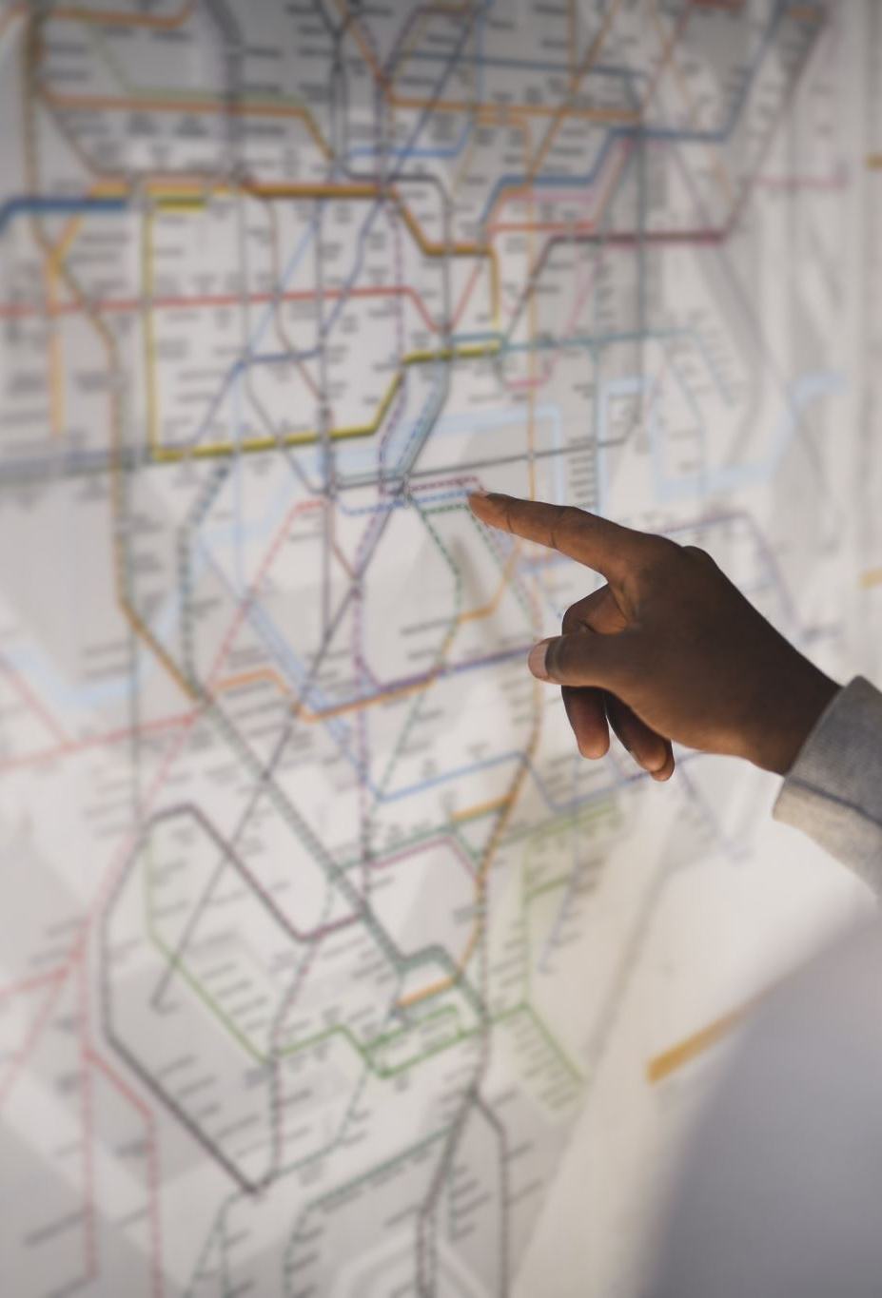
Now, once the voting is done, the members can decide if they want to visit 2-3 destinations simultaneously or just 1 would suffice. If they want multiple destinations, then we can implement the multiple location route system that exists in Google Maps. (Since we would be using Maps API, it should be a fairly straight forward process).
Once all the decisions are made, they can generate an offline map of the entire route that they could follow to reach all their desired destinations! Since the internet connectivity cannot be guaranteed throughout the journey, it’d be wise to get an offline version rather than getting stuck somewhere.

Slide 11

As we can see on page 7, pressing the bottom right button will take us to a different screen which has the Google Maps API. Once the voting is finalized and we have our destinations ready, the app will automatically create a map in the background.
We can close the voting pop-up and focus on the other aspects.
‘Generate Map’ button will download an offline copy of the entire journey.

Slide 12
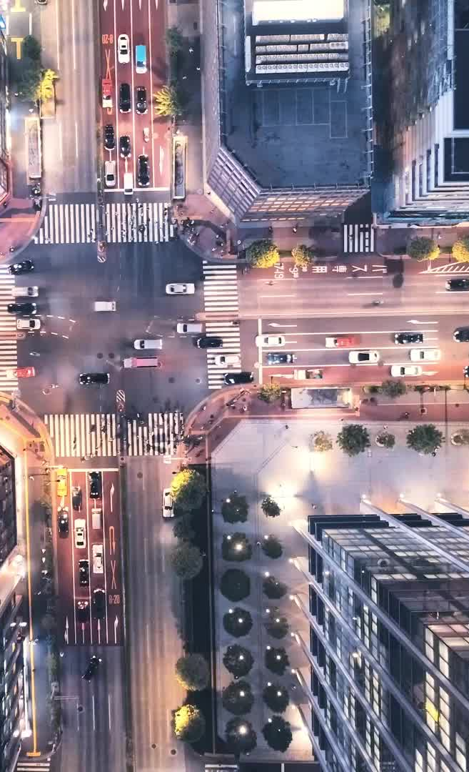
Now, we have everything sorted out! BUT, when should you visit the place?
For this, we can add in a feature that will fetch the best time to visit the finalized locations and take the intersections of all those periods in order to get the most optimal time when you should visit the place.
For example: It is advisable to visit Goa during March-June and then during September-November. And assume that our other destination is Kerala where it is advisable to visit during September-March, so the most optimal time for this entire trip would be: September-November

Slide 13
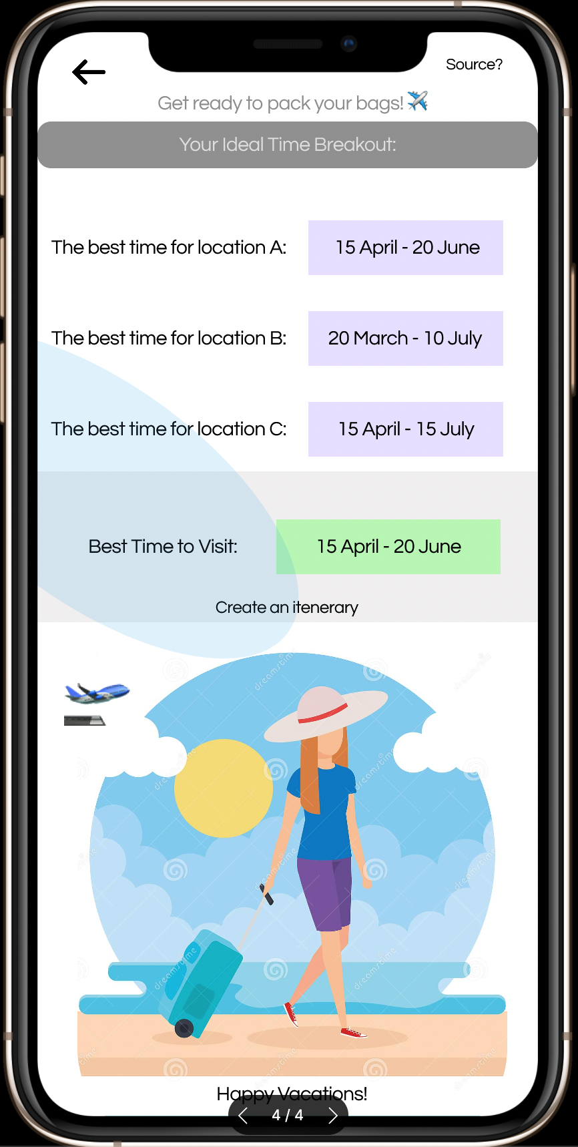

Slide 14

If you want to create an entire itinerary or a checklist of items, you will want? Worry not, we have that covered as well. We can add a shortcut link to websites like Canva, MakeMyTrip, etc. that will take the user directly to their itinerary formation portal, with their information already fed to these websites (information- the place they would be visiting and the timeframe too) (*)
The above point is a bit crucial for later (Hint: it will be used to discuss whether we can use this redesigned Google Meet to generate revenues or not!)

Slide 15
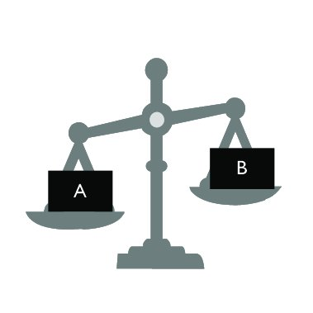
Trade-offs and Other Issues?
By hyperlinking other sources, we are driving a portion of our users to other sources. This can lead to some reduction in number of users!
There are some issues that can arise while planning the trips through this app:
Multiple timeframes are suggested to visit a location (like mentioned earlier, there are 2-3 different time windows in which visiting Goa is advised)
Someone suggested something irrelevant? In a group of friends, a lot of times people joke, and they might end up putting ‘Pizza’ as their desired location just for fun! You cannot practically generate an itinerary for Pizza.

Slide 16
Solutions to these issues
For the multiple time-frames, we can improve the algorithm of suggesting the final duration. We can include the ’OR’ condition to consider all the time-frames for a single location, further use the ‘AND’ condition across locations to get the final time-frame(s)
Fir the other issue, suggesting an irrelevant place can be avoided by using the same search API used by Google Maps originally, we need to select something to get proper directions! Further, to add a layer of sanity checks, we can get a list of tourist spots/famous places people visit. Now, if a suggestion is not from that backend list, we have 2 cases:
Either it is irrelevant (we need to weed it out)
Or it is a unique place.
If it is not a proper city or location, we will throw an error saying, ‘Invalid Location Entered’. This should take care of most of the issues.

Slide 17
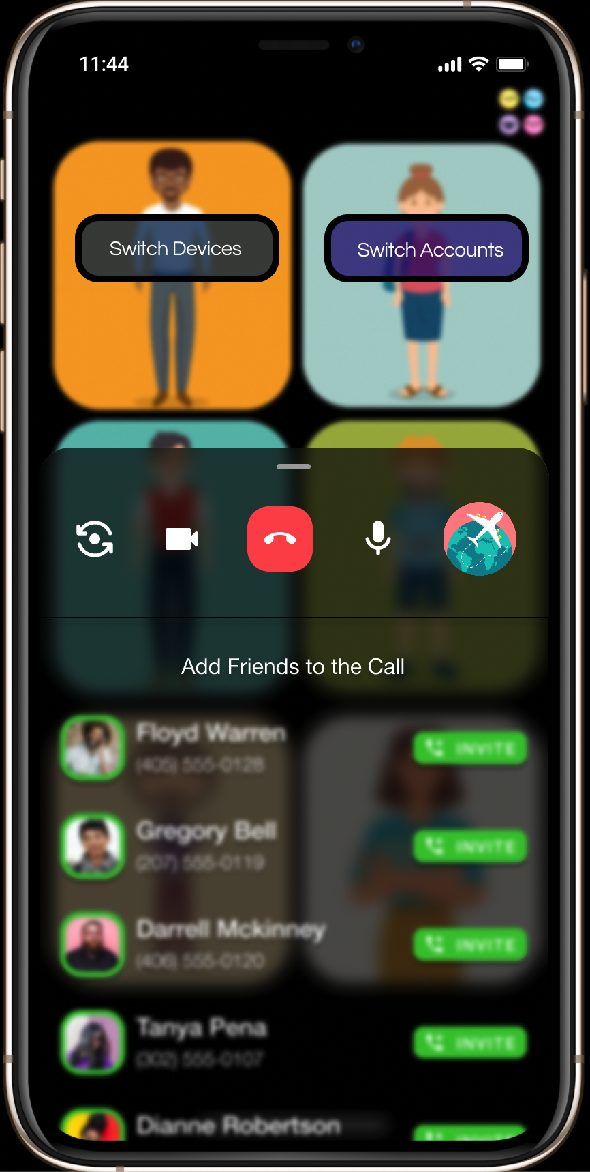
Extra Features!
If we look carefully, we will see some buttons that are not discussed yet, and these actually are some little handy features that we’ve incorporated.
Let’s say you have multiple accounts and you have entered with the wrong one, you can always switch accounts!
Let’s say you get in impromptu call, you receive it on your phone, but actually wanted your laptop. No worries, this button helps you transfer the call to your laptop without doubling of the profile as usually happens.
Note: Since these 2 features can be considered a threat to data safety, this is not advised for any enterprise use. But since with friends and family, it is mostly casual, so giving the privilege of shifting the device or changing accounts without the host’s permission isn’t such a bad idea.

Slide 18
This Source button will take the user to the website using which we get the best time for visiting the selected cities. (this is purely for users’ satisfaction)
The drop-down button on ‘Suggested By’ and ‘Votes’ are for sorting; they will be used to decide the final destinations based on most votes.
If there are multiple members, like 15-20, then it is not really sensible to use stars to showcase the votes.
So, once ANY of these vote counts get > 5, all of them will be converted to numbers automatically.
This button will take the user to websites for creating their itineraries and list of essentials to carry.

Slide 19
Can it bring revenue?
Finally getting to one of the most important questions, can it bring revenue? Yes, it can. But how so, since all the users are using it for free?
The way we can monetize this model is already mentioned before (Yes, we are indeed talking about the (*) marked point from earlier)
By hyperlinking a 3rd party service in our app, we are driving a fraction of our own traffic towards them! This opportunity can be used to monetize this product
And since for the 3rd party services, engagement matters a lot, we can charge them for featuring them in our app. We can do it on contract basis too.
We can tie up with services like Canva, MakeMyTrip, etc. We will provide refer our users to their platforms to get their itinerary and checklists, etc. in exchange of a revenue fee.

Slide 20

Metrics to track success!
Now that we are finished with the design and sanity checks, let us go through a list of metric that I believe will be relevant in tracking the success of our product.
Here is the list:
How many users use the trip planner
How many users use the trip planner again! (this will tell us if the users are actually coming back to our product or not)
The revenue that is being generated from the 3rd party services will also contribute as a metric here.
New sign-ups (if any). This is not that important, as most of the people already have a working google account, so new people are not of the utmost importance.
Number of downloads of the offline map. (Some people will ignore downloading the offline map, trusting that they will get the networks all the time, so this becomes an important factor here)

Slide 21

Summary: Let’s bring it all together!
We are aiming to create a trip planner integrated inside a video call app. This app will help the users plan, choose and even decide their dates for the visit!
We are using the already existing Google Maps API to build this, so the implementation should not be expensive in any manner.
We are also adding in loads of small features that will help users get the best experience.
We will try to monetize this product by charging the 3rd party services for providing them a space to grow their own product through our audience.
Link to the original design: You can find the design here. It is a Figma design file. Please go through it for your reference!

Slide 22
Thank you!
Thanks a lot for going through this entire presentation. I hope you liked the idea!
I am always open to suggestions and constructive criticism. Please let me know how you liked my idea and its implementation and feel free to reach out to me for any clarifications in future on the contact details mentioned on the 1st page!
Looking forward to hearing from you : )

